Slide 1
Math 769: Statistical Learning

Slide 2
Piecewise Polynomials
Shahrzad Jamshidi, PhD

Slide 3
Last Time
We discussed the basic idea of basis expansion methods.

Slide 4
Objectives
Define a spline.
State the advantage of splines over high-degree polynomials.
Define a knot.
State the model of a cubic spline.

Slide 5
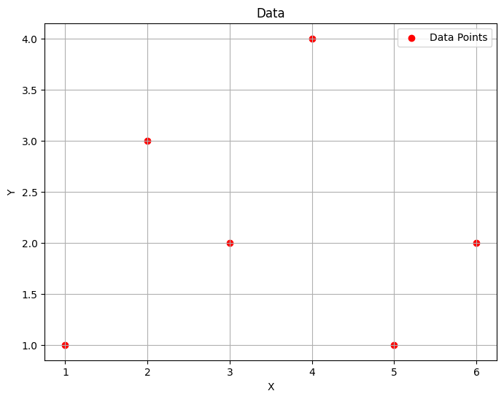
Introduction
Suppose the “ideal” model goes through all the points.
Such a function could not be linear.

Slide 6
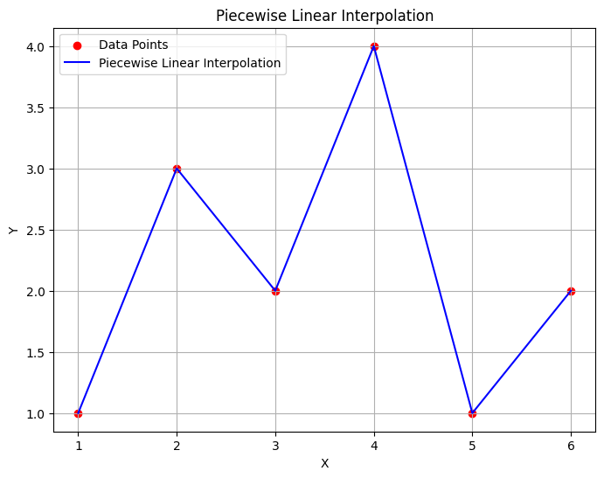
Introduction
A piecewise linear model provides a way to go through all the points,
but provides little predictive power and
virtually no insights into the relationship between variables.

Slide 7
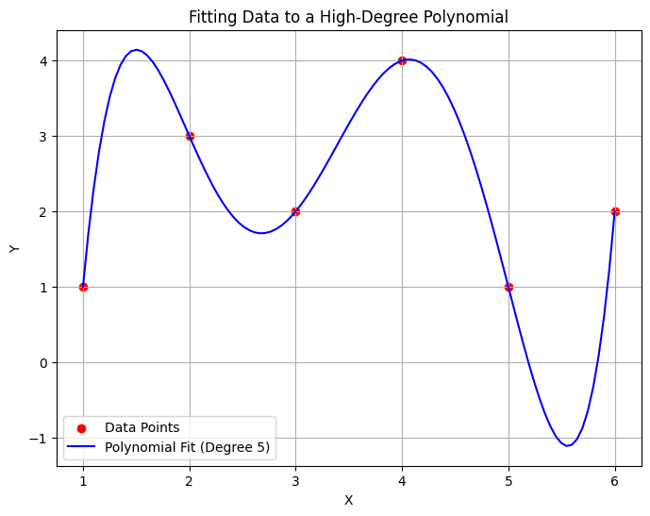
Introduction
A high-degree polynomial can achieve a more smoothed out model.
But notice that we have more extreme peaks.
This reduces the predictive power.

Slide 8
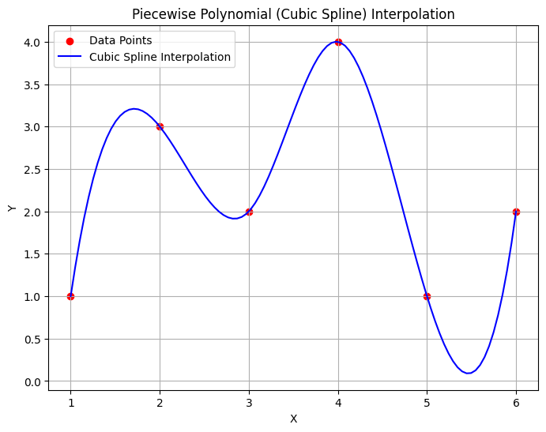
Introduction
Piece-wise polynomials keep local degree low.
Peaks are less extreme than high-degree polynomials.
These are the kinds of models we are interested in for this lesson.

Slide 9
Splines
A spline is a function defined piecewise by polynomials;
Advantages:
Simple construction,
Easy to evaluate,
Can approximate complex shapes, and
Relies small datasets and go through all points.

Slide 10
Why do I want to go through all or most of the points exactly?
Notes:
This is where the linear algebra comes in

Slide 11

Applications
Modeling physical, curvy surfaces or paths
Measured points are assumed to have very small error.

Slide 12
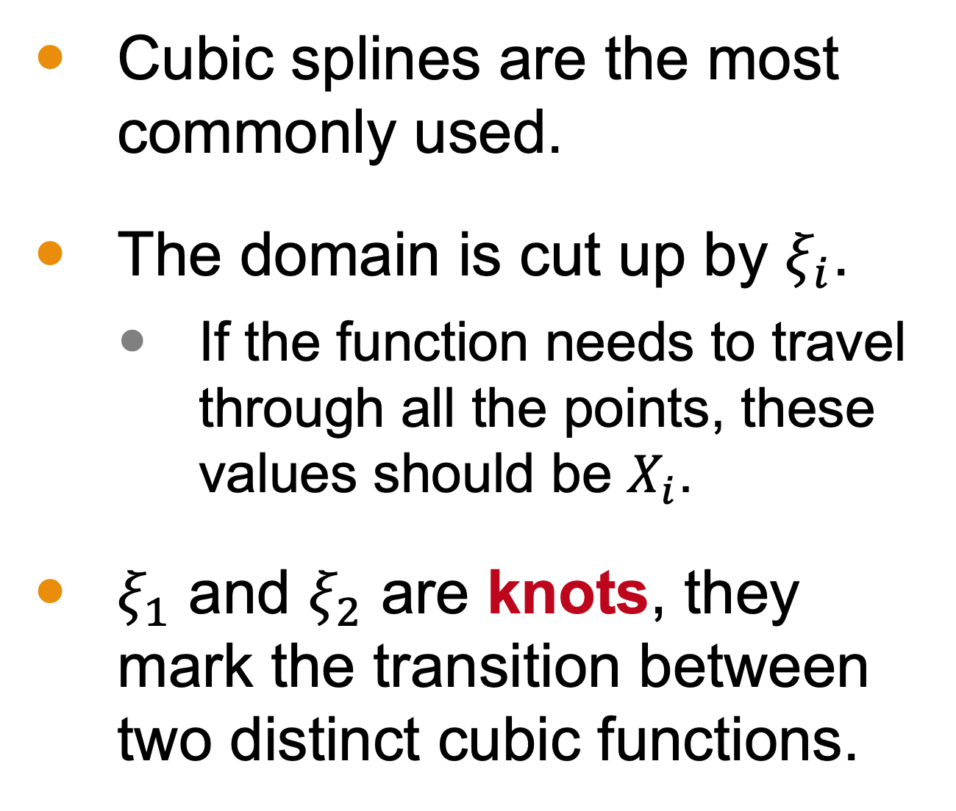
Cubic Splines
Cubic splines are the most commonly used.
The domain is cut up by $ξ_{i}$.
If the function needs to travel through all the points, these values should be $X_{i}$.
$ξ_{1}$ and $ξ_{2}$ are knots, they mark the transition between two distinct cubic functions.

Slide 13
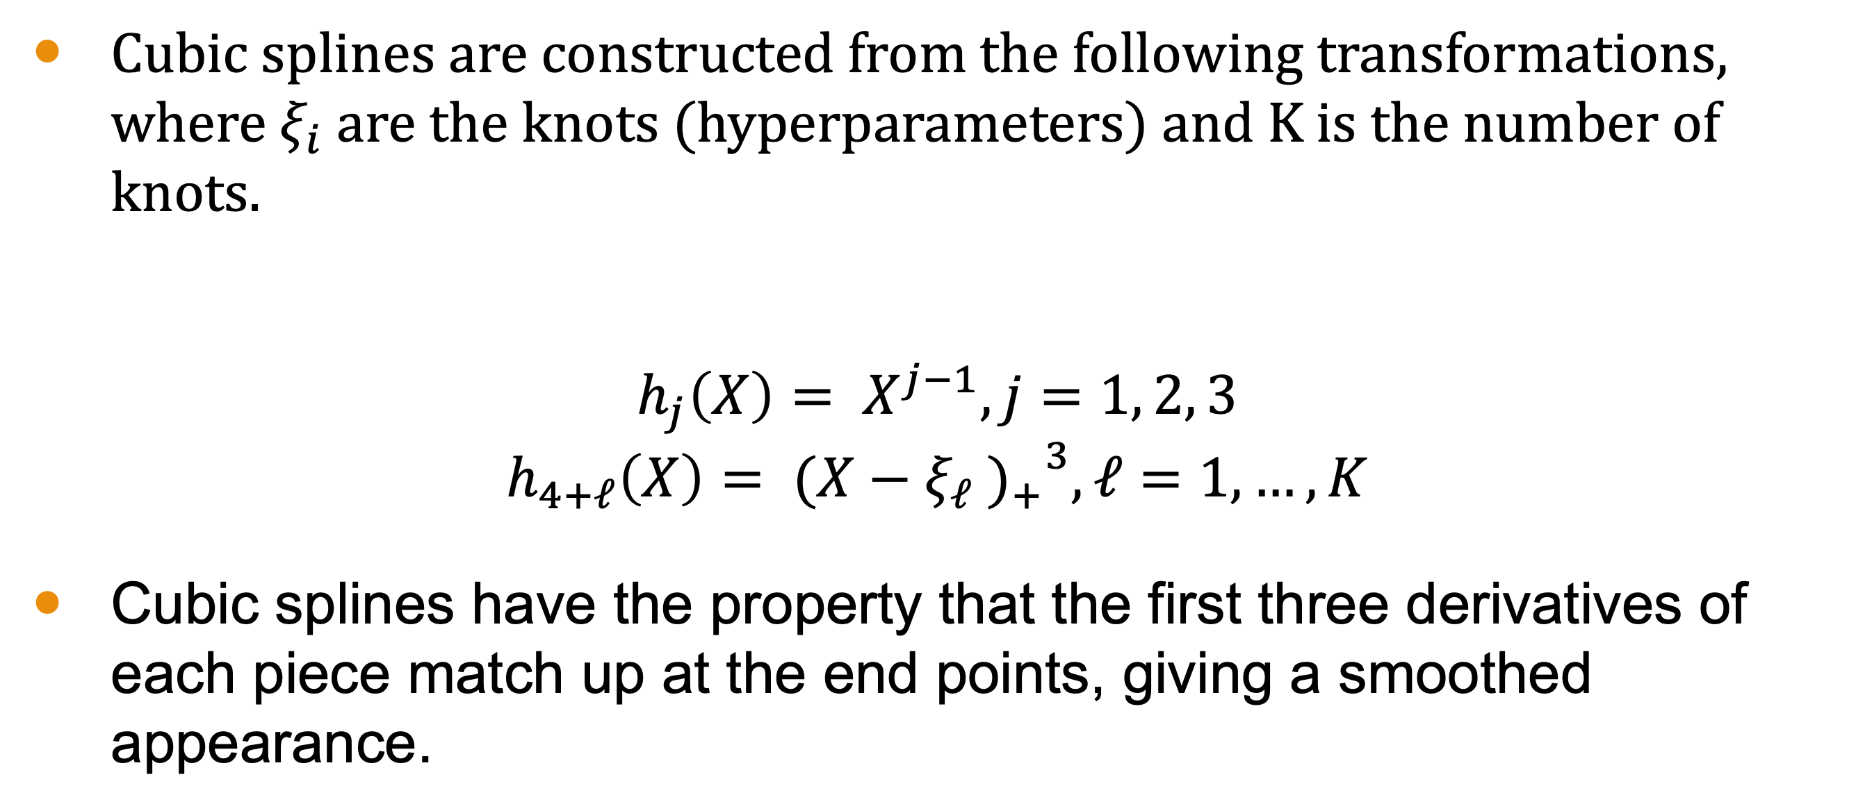
Cubic Splines
Cubic splines are constructed from the following transformations, where $ξ_{i}$ are the knots (hyperparameters) and K is the number of knots.
$$h_{j}\left(X\right)= X^{j−1}, j=1, 2, 3$$
$$h_{4+ℓ}\left(X\right)= {{(X−ξ_{ℓ} )}_{+}}^{3}, ℓ=1, …, K$$
Cubic splines have the property that the first three derivatives of each piece match up at the end points, giving a smoothed appearance.

Slide 14
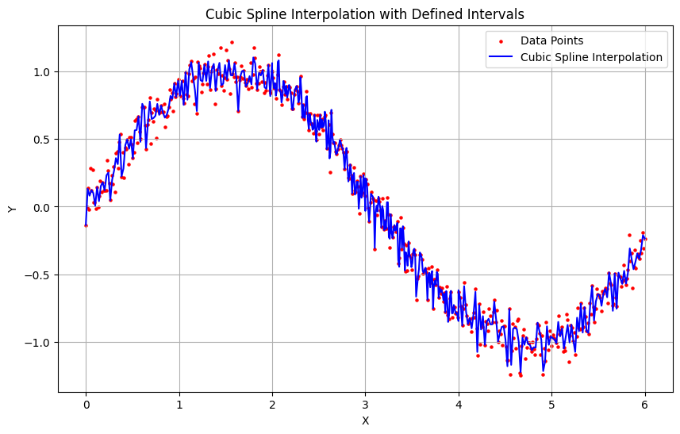
Example
The example on the left models 500 points with X values between 0 and 6.
When programming this, we use the SciPy library, which automatically generates intervals to go through as many points as possible.

Slide 15
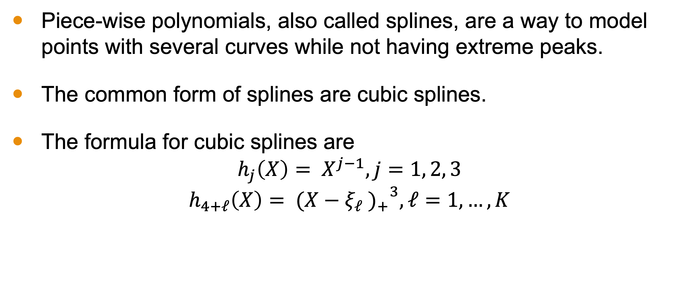
Conclusion
Piece-wise polynomials, also called splines, are a way to model points with several curves while not having extreme peaks.
The common form of splines are cubic splines.
The formula for cubic splines are
$$h_{j}\left(X\right)= X^{j−1}, j=1, 2, 3$$
$$h_{4+ℓ}\left(X\right)= {{(X−ξ_{ℓ} )}_{+}}^{3}, ℓ=1, …, K$$

